Slide 1


Insights Discovery Introductory Workshop 2024

Slide 2
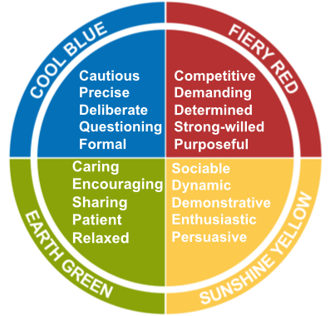
Introductory Team Workshop –Overview
Introduction & Mindset: Setting the session up for success and the impact of our mindset on our life and work
Perception: We see the world not as it is, but as we are.
Introduction to Insights Discovery: Understanding the Insights Discovery model, individual preferences and how this impacts our relationships
Sharing Profiles: Self reflection and team sharing around communication preferences
Review of Team Wheel: Discussion and observations around team dynamics and effectiveness.
Practical Application & Tools: How can you use your profile on a daily basis as a team?
Investment
Insights Discovery Profiles & Workshop Materials: £150 + VAT per person (Foundation, Management Chapters)
Online workshop facilitation & preparation: £1100 + VAT (half day)
In person facilitation: £1500 + VAT (for half day) or £2250 + VAT (for a full day)

Slide 3

Further Reading Information

Slide 4
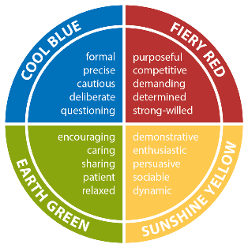

About Insights Discovery
Self-awareness is the foundation of excellent teamwork, improved communication, enhanced productivity and truly inspirational leadership. Insights can raise the level of self-awareness throughout your organisation, and help you move into a highly successful future.
The Insights Discovery model is a simple and accessible four-colour model which, accompanied by an Insights Discovery Personal Profile, helps people to understand more about themselves and others.
It creates a common language that makes it easier to identify strengths and address weaknesses, so that individuals and teams can perform at their highest level.
This model provides an effective foundation for learning programmes since it inspires individuals to think about how they act and communicate.
Every person has all four colour energies within them but has a natural preference for some over others which influence their motivations and behaviour; it is the combination of these energies which creates each unique personality.
By understanding your own and others’ preferences better, you can take simple, practical actions that improve your everyday relationships. The Insights Discovery Personal Profile is your guide, enabling you to take control of your own development.
Supporting your existing tools
Our purpose is to help you use the Insights Discovery system to accelerate the transformation of your business and the personal growth of your people. One of Insights Discovery's greatest features is its versatility; it can integrate and support other systems already in place by providing a common, easy-to-use language that is shared across whole organisations.

Slide 5
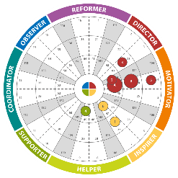

Benefits of Insights Discovery
The Insights Discovery methodology allows individuals to view their personal preferences in relation to those of others, making it easy to identify where they may come into conflict, and where they share common ground.
Team wheels give you a highly visual representation of your
team’s personal preferences
Some of the advantages of Insights Discovery that learners have listed:
Using meaningful words like
Fiery Red or Earth Green makes everything more memorable.
Being able to compare wheel positions
in a team is very impactful.
The profiles have great Information that can
be applied on a daily basis, both inside and
outside the workplace.
In addition, the Insights Discovery model is registered with the British Psychological Society and carries their PTC mark of approval for use in work and occupational development. Insights Discovery has also been awarded the coveted Occupational Test Tools Certification Mark, from global quality assurance and psychological test assessors DNV GL.

Slide 6
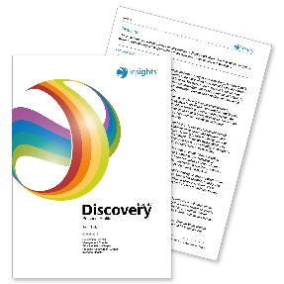
The Insights Discovery Personal Profile
The Insights Discovery Personal Profile is a detailed report about each individual which is produced based on their responses to an evaluator. It contains valuable information about the individual's personality and communication preferences that can be used as an aid to self-development in the workplace.
Foundation Chapter
Every profile begins with the Foundation Chapter, which tells individuals about their style and approach. It includes the following sections:
Overview
Key Strengths and Weaknesses
Value to the Team
Communication
Possible Blind Spots
Opposite Type
Suggestions for Development
Download a sample here.
This gives the individual a good understanding of their unique preferences so that they can start to make practical, relevant changes that improve their working processes and relationships.
Management Chapter
We believe that everyone is a leader in their own way. It’s how you lead, not what you lead, that really matters. The Management Chapter helps people to understand how they manage, and how they prefer to be managed. It is useful for both leaders and the people they lead to explore the best ways of working together, improving both their relationships and performance. This chapter focuses on:
• How people like to manage and be managed
• How to motivate others and be motivated
• Creating an ideal work environment for yourself and others

